Slide 1




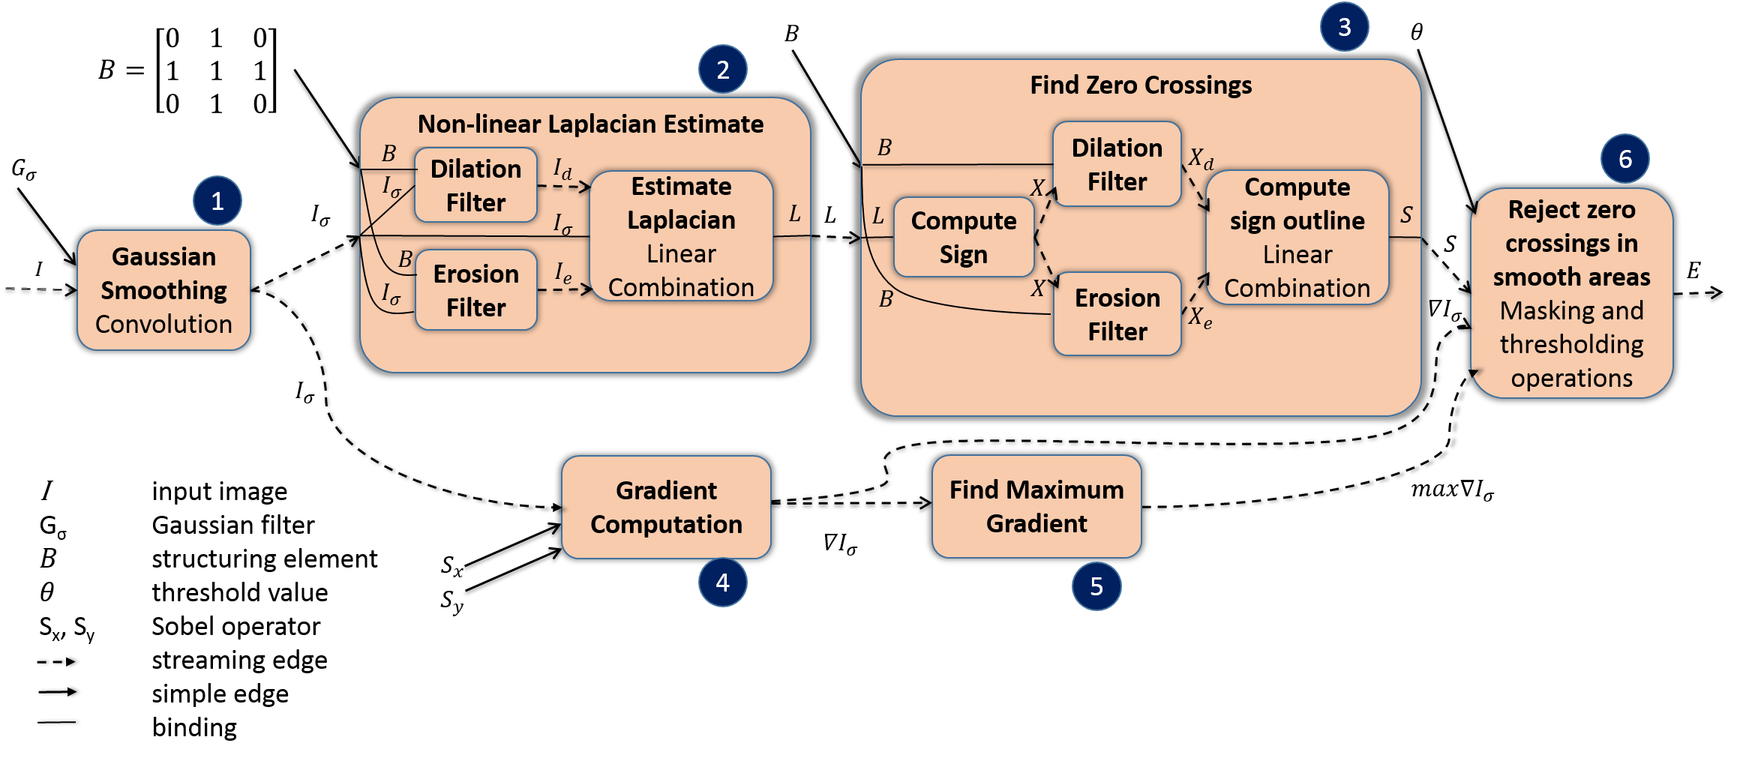
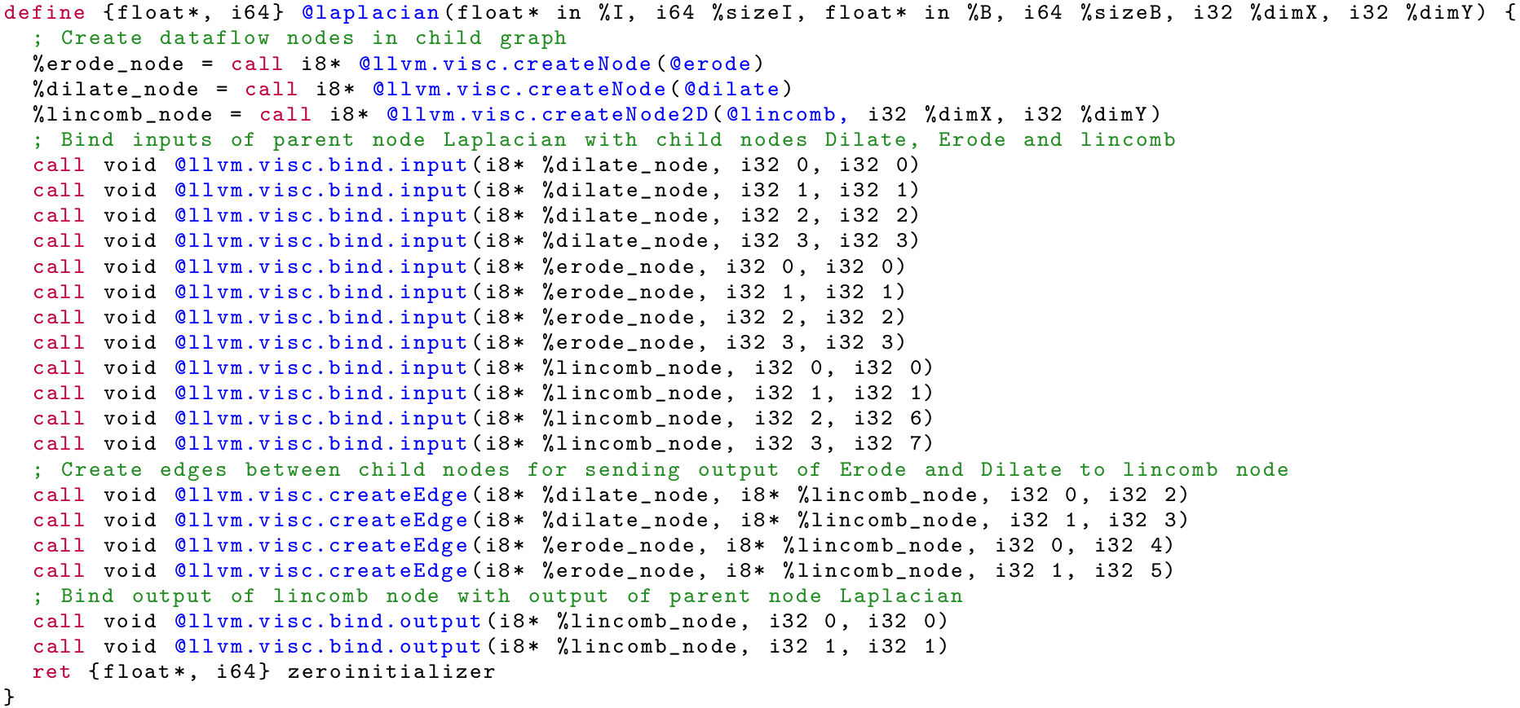








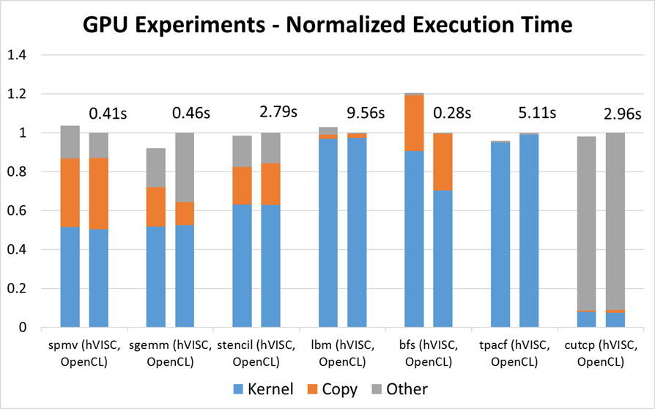
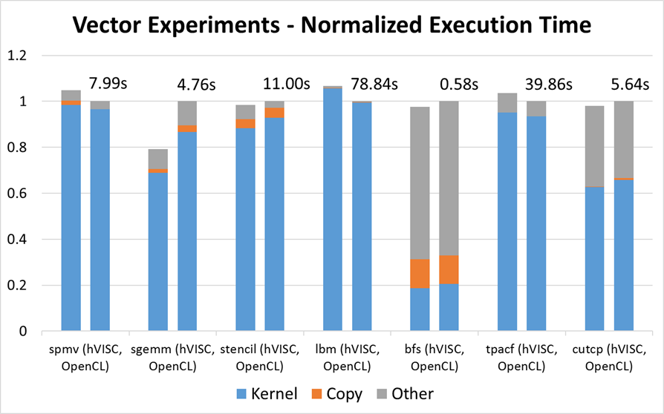


hVISC: A Portable Virtual Instruction Set for Heterogeneous Systems
Prakalp Srivastava, Maria Kotsifakou, Matthew D. Sinclair, Rakesh Komuravelli, Vikram Adve and Sarita Adve
Center for Future
Architectures Research
COMPUTATION, PLATFORMS
DESIGN TOOLS FOR HETEROGENEOUS SYSTEMS, MAPPING DIVERSE SOFTWARE TO HETEROGENEOUS SYSTEMS
Motivation and Goals
Heterogeneous Systems promise to address the power wall problem
But, programming heterogeneous systems is hard!
≥ 6 different hardware ISAs, ≥ 7 different parallelism models & Incompatible memory systems in a SoC
hVISC: Virtual ISA for Heterogeneous Parallelism
Example: Edge Detection on Greyscale Images
N different parallelism models
only two parallelism models!
Hierarchical Dataflow Graph
with side effects
Vector Instructions
Goals
Object code portability
Good performance on a wide range of
hardware
Challenge
Provide common abstractions for different compute units
Modern smartphone SoC
V_{A} = load <8 x float>* A
V_{B} = load <8 x float>* B
…
V_{C} = fmul <8 x float> V_{A}, V_{B}
Compact
Easy to analyze
Highly portable through
careful design (LLVM)
Modem
CPU
CPU
GPU
GPS
Vector
Vector
A/V Hardware Accelerators
DSP
DSP
L1 Cache
L1 Cache
DSP
Multi-media
or
L2 Cache
Intuitive
Captures data parallelism
Captures streams, pipelines
Captures semi-custom
accelerators
Captures shared memory
Interconnect
Main Memory
Solution: Virtual Instruction Set Computing (VISC)
Why Hierarchical?
Multi-level parallelism
Modularity
Example: Creating a hVISC Dataflow Graph Node
OpenCL
RenderScript
AMP
OpenMP
Lime
Habanero
Delite
DSLs
Source level languages
Parallelism across + within compute units
Guides the scope of optimizations
Simplifies program development
Enables code reuse
Common low-level, virtual ISA
    Should abstract away hardware differences
    Need good parallelism, memory abstractions
Previous examples
  expose too many GPU-specific details
  are not suited for different parallelism models, i.e. streaming parallelism
    PTX, HSAIL, SPIR
Create Nodes
Bind Inputs
Laplacian
Front End Compilers
Expressing Data Parallelism
via Node Replication
Expressing Streaming Parallelism
via Streaming Edges
Dilate
Linear Combination
Virtual ISA
Single Static Dataflow Node
Multiple Dynamic Instances at Runtime
Simple Dataflow Edge
Streaming Dataflow Edge
Erode
Translators
Runtime Scheduler
Performance
Portability
Create Edges
CPUs + Vector SIMD Units
…
DSP
Single data transfer
Nodes destroyed after computation is completed
Multiple data items may be transferred
Nodes continue computation on available data items
GPU
Programmable accelerators
Unit of Computation
Represent replication of computation over multiple data items
Carefully designed virtual ISA can resolve the tension
between performance and portability
Compilation Strategy
Evaluation
hVISC binaries generated from single hVISC object code
Compared against optimized OpenCL implementation
Performance
Implementation
Portability
Compile, optimize and ship hVISC binary
Install-time, device-specific translation
  Dispatch subgraphs to appropriate backends
  One subgraph → one or more backends
  Backends generate target specific binaries
Benefits
    Portability across SoCs
    Address performance-energy trade-off
      Schedule execution on most suitable hardware
      Efficient data transfer using SoC specific library
C with hVISC extensions
Carefully designed Virtual ISA
Modified Clang
hVISC Binary
Future Work
Flexible Scheduling
Autotuning
Backend translators for a variety of target devices
Reusable parallel IR for optimization
Source level languages
  Support for successful existing programming languages
  New language abstractions as extensions to existing languages
Host code x86 binary
SPIR binary
Host code x86 binary
Host code x86 binary
PTX binary
Intel OpenCL runtime
P-threads
Library
nVidia OpenCL runtime
Intel Xeon E5 core i7 with AVX support
Intel Xeon E5 core i7 with AVX support
nVidia GeForce
GTX 680 GPU
Within 1.2x
Within 1.06x

